Slide 1
History of and Approaches to Planning

Slide 2

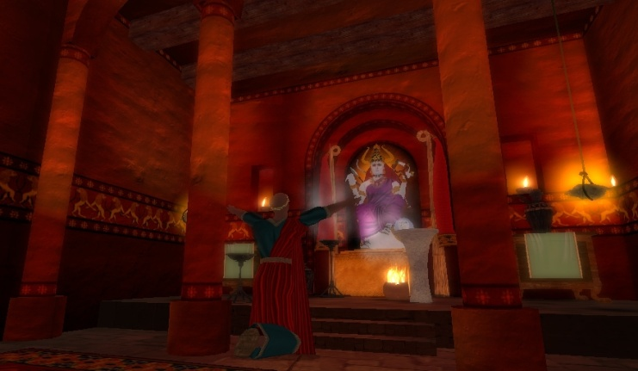
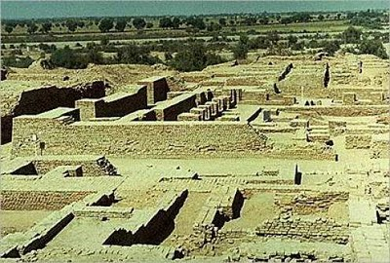
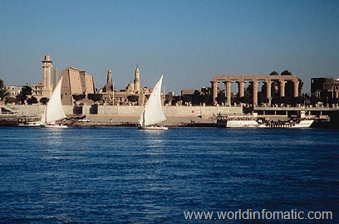
Historic Planning
Ancient cities were places of:
  Defence
  Worship
  Regional political control
  Economics
Notes:
Defence, Great Wall of China
Worship, Mexico
Political control, Athens
Economics, Ancient Mesopotamia

Slide 3
Greeks
Ancient Greeks developed rectangular blocks of residential land use, for sun exposure
Public spaces were developed on major streets
Agora - marketplace
Streets surround residential buildings

Slide 4
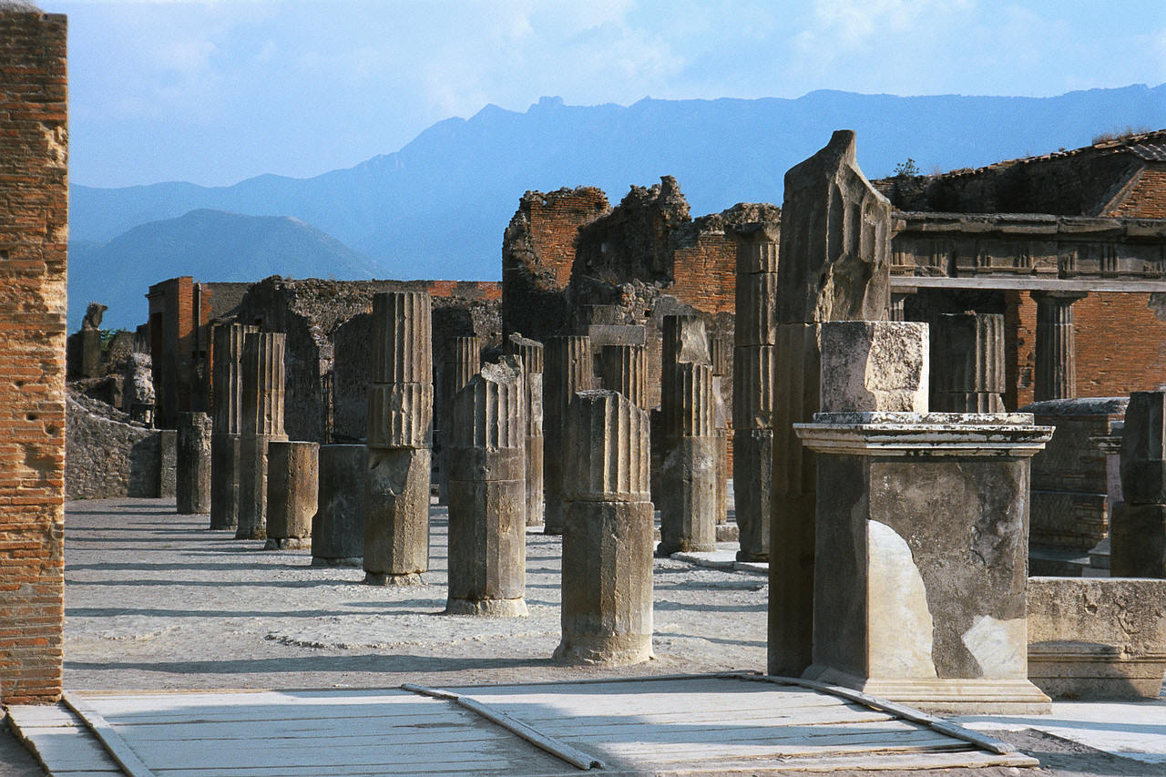
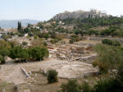
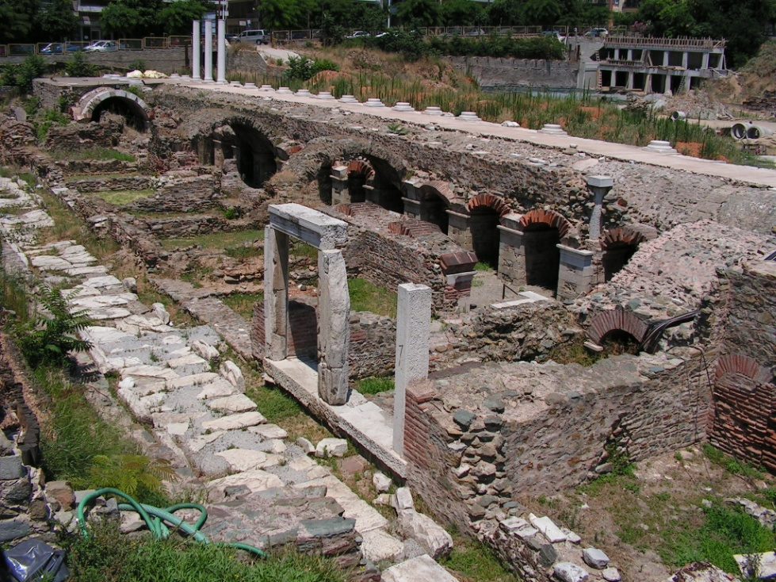
Notes:
Streetscape, open space, agora all in Pompai

Slide 5
Romans
Roman cities had north/south and east/west major streets, intersecting at the center
  City center is the site for the forum
Many garrison towns that tended to have rectangular street patterns within the wall and radial patterns outside of the walls

Slide 6
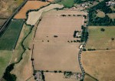
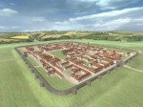
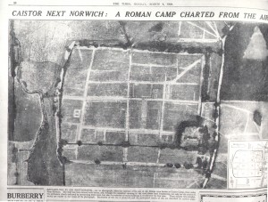
Venta Icenorum, on the river Tas on the outskirts of the modern village of Caistor St Edmund

Slide 7
Physical Form of Ancient Cities
Because new towns were built where there had previously been unoccupied land and the town had to meet social, physical and economic need they needed to be:
  Simple and easily laid out
    Block pattern of land assigned to residences and public usage
    Defensive walls limited outward growth

Slide 8
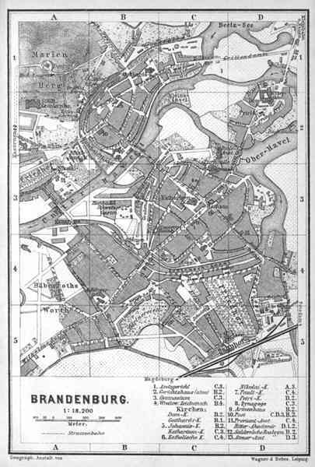
Dark and Middle Ages
Characterized by social formlessness and lack of large settlements: led to organic urban form
New towns were planted towns or bastides: fortified and organized

Slide 9
Renaissance and Baroque Cities
City became an object of design and a way to express the aesthetic and functional aims of the period
  Functional aims: order, discipline, desire to impress
  Aesthetic aims: symmetry, coherence, perspective, monumentality
City design focused on: the main straight avenue, the gridiron pattern and enclosed spaces

Slide 10
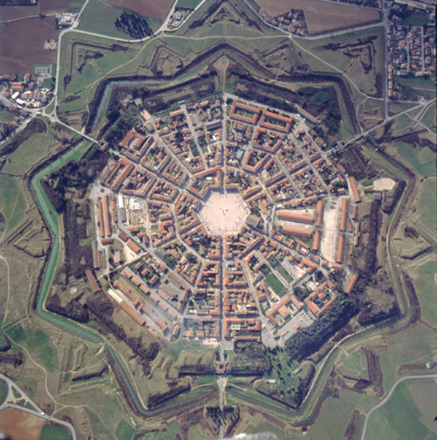
Palmanova, Italy

Slide 11
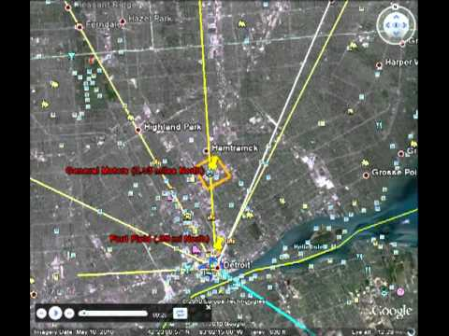
Detroit, MI

Slide 12
19th Century Idealist Planners
Idealism as a reaction to industrial cities of the Industrial Revolution (overcrowded, poor water supply, filth, sewage, disease)
  The Utopians
    Cooperative community of industry and agriculture
    Single large communal building in which relationships could be “harmonized”
    Application of ecological principles to urban areas: human life intertwined with both natural and manufactured landscapes

Slide 13
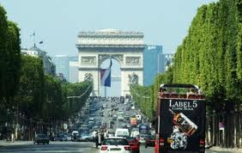
Idealists, con’t
City Beautiful Movement – focus on renaissance ideals, desire to incorporate aesthetics into built environment (eg. Landscape architecture, public parks, well designed civic centers)

Slide 14
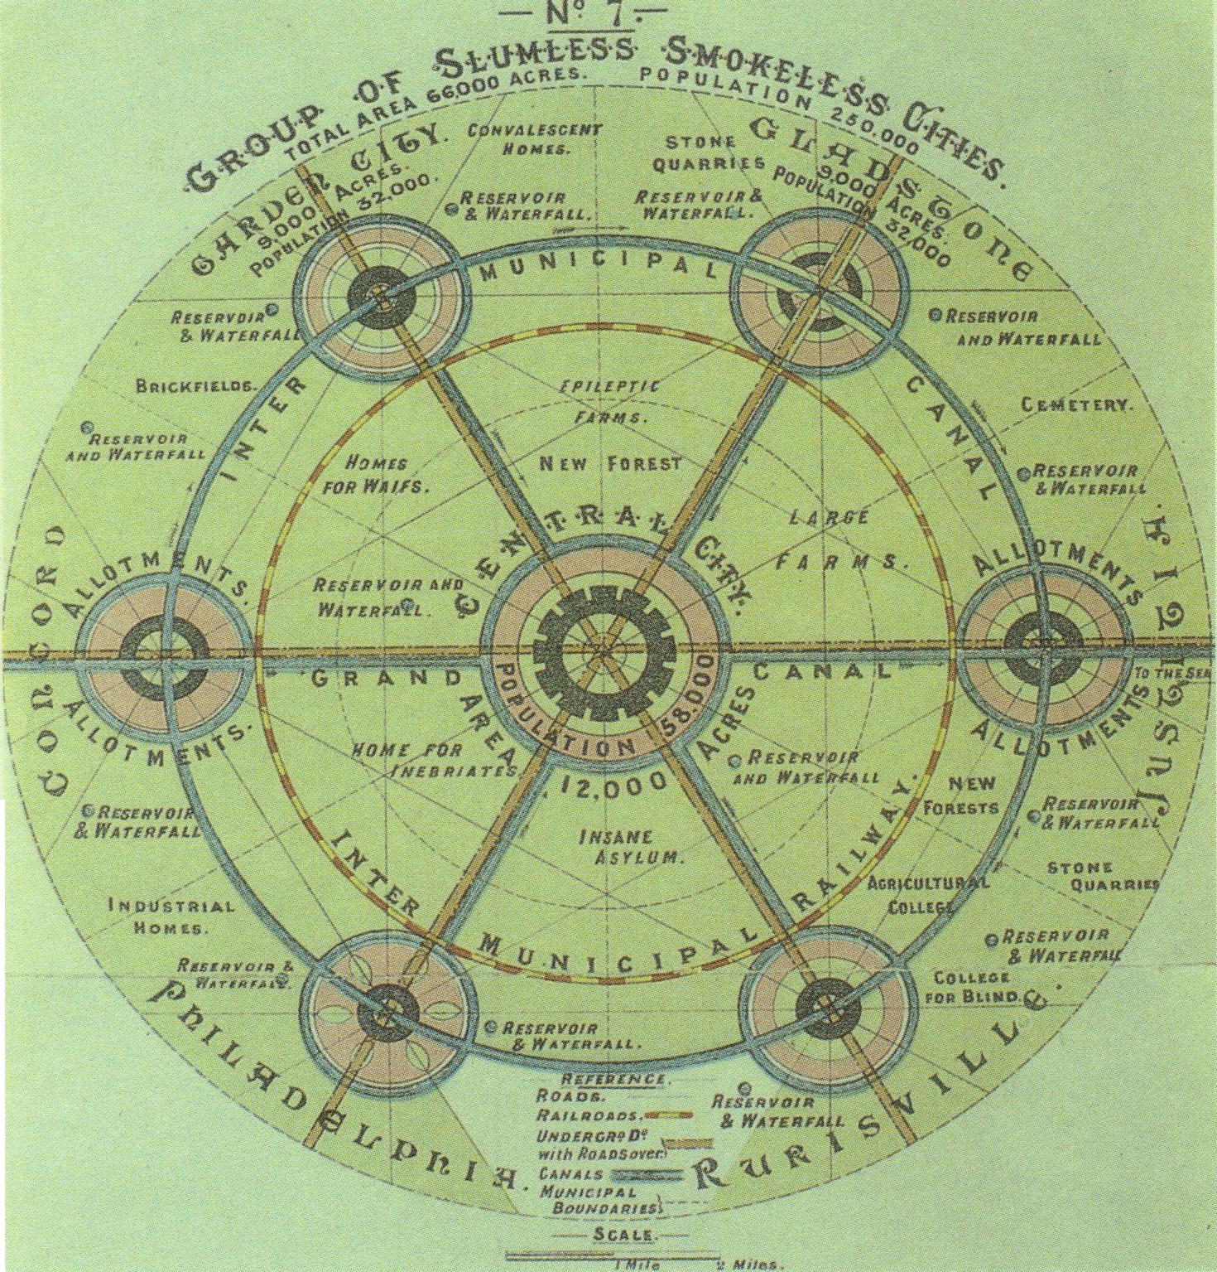
Idealists, con’t
The Garden City – a satellite town that would disperse the population of a large city into smaller groupings, and would create community on the periphery of large cities that were more pleasant to live in

Slide 15
Post WWII Planning
Planning was differentiated from architecture
Main characteristics:
  Town planning was seen as purely physical
    Deals only with land, and does not involve social, economic or political planning
  Design as central to town planning
    Design used to develop functionality eg. roads, separation of land uses
  Town Planning involved development of “master plans” or “blueprints”
    Plans for the future; they needed to be detailed, seen as a product to produce
  Based on the cultural, regional and national values of the time; specific to the geographical area planned for. For example, post war Britain planned differently than post war America

Slide 16
Summary
Ancient Greeks – public spaces including marketplaces, rectangular residential blocks
Romans - cities had north/south and east/west major streets, intersecting at the center
Dark and Middle Ages - social formlessness and lack of large settlements or fortified and organized
Renaissance and Baroque - City became an object of design and a way to express the aesthetic
Industrial Revolution -overcrowded, poor water supply, filth, sewage, disease
Idealistic 19th Century - a reaction to industrial cities of the Industrial Revolution including City Beautiful Movement, Garden City
  Post WWII - Town planning was seen as purely physical and focused on the development of Master Plans and Blueprints
12th to 21st Century Development

